Slide 1
Elements Review

Slide 2
Texture

Slide 3
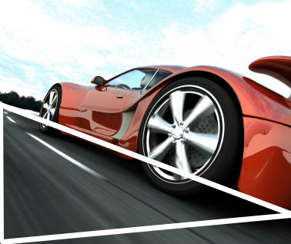
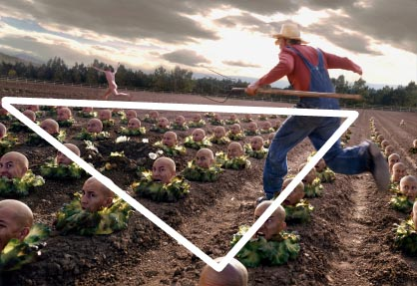
Shape

Slide 4
Value

Slide 5
Space

Slide 6
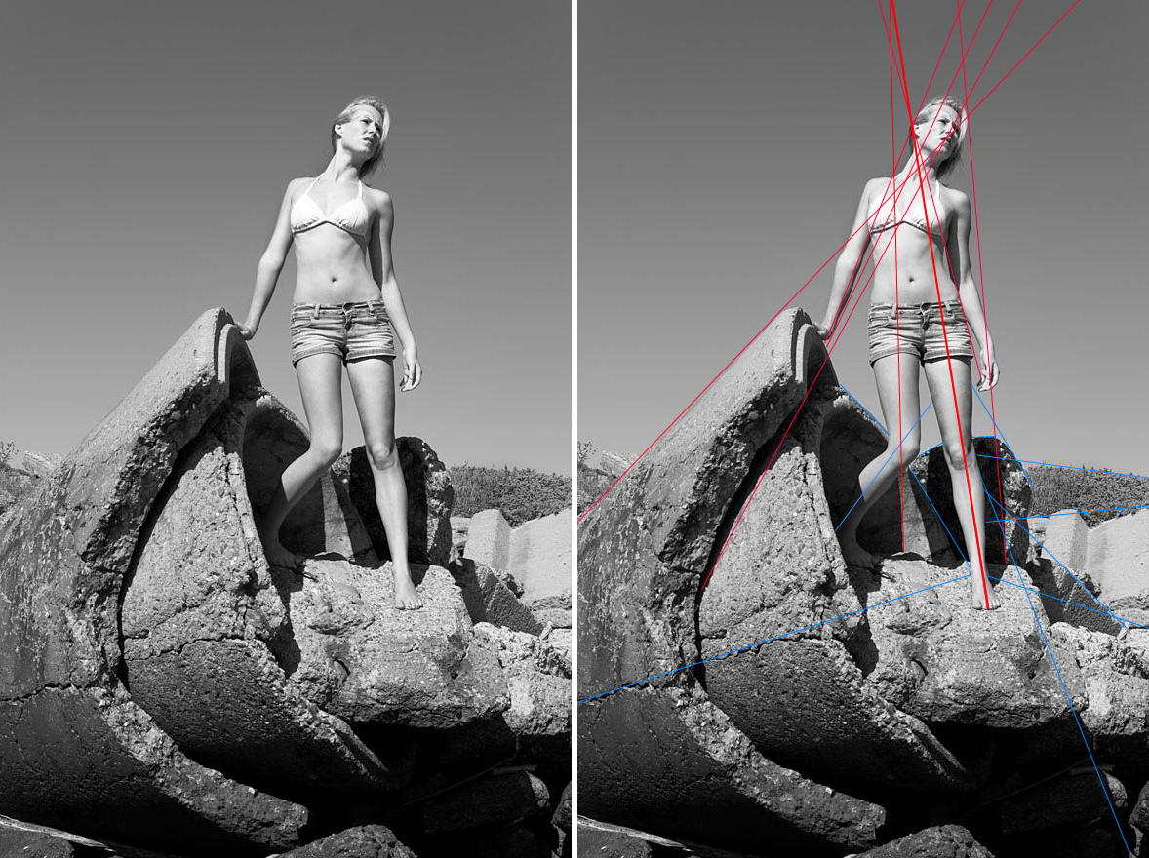
Line

