Slide 1
Themed Montage

Slide 2
Objectives:
Learn Free transform, Layers, and move tool in PS
Find 15 photos within a theme and create a montage

Slide 3
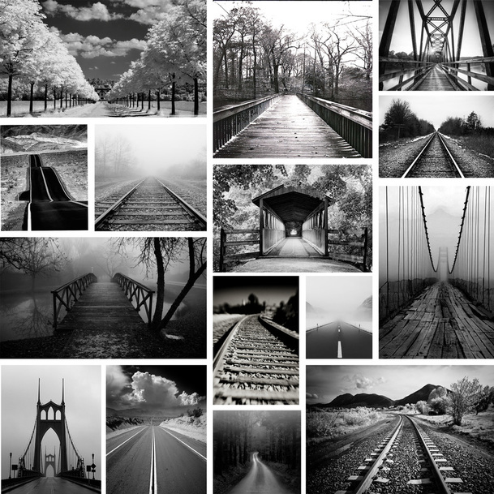
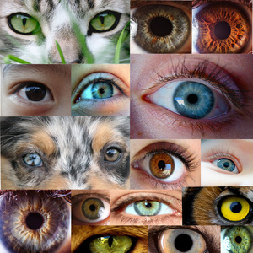
Mia Donnelly
Diego Monroy
Moriah Clarke

Slide 4
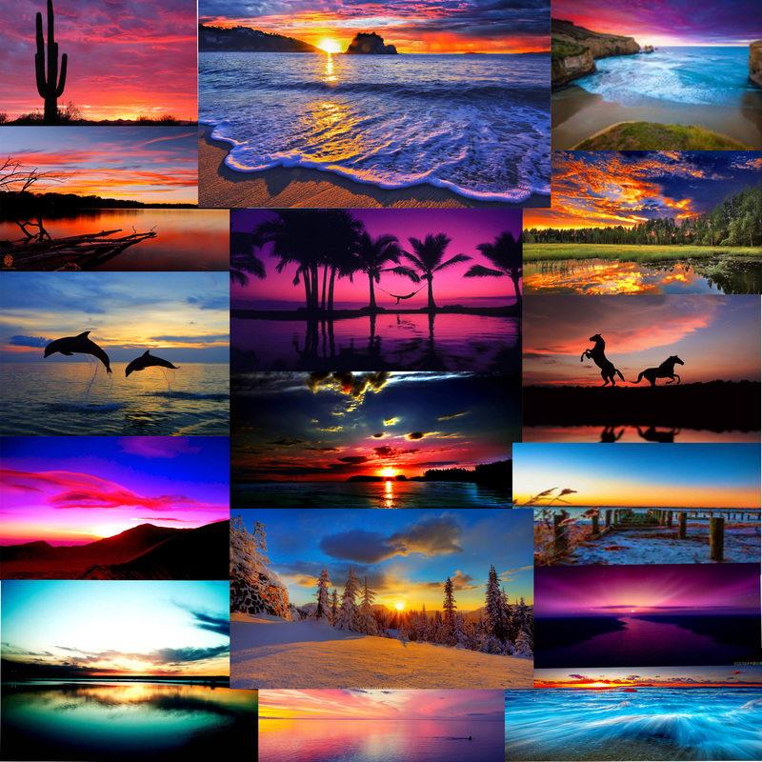
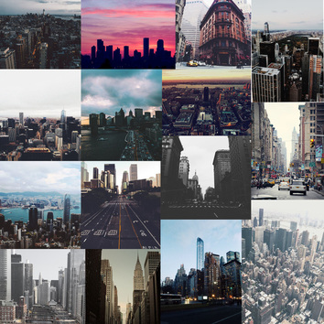
Sydney Puccetti
Tanner Gates
Nick Korytko

Slide 5
Steps:
Collect 15+ photos from google, using Search tools: SIZE=LARGE
Click view image, DO NOT SAVE FROM GOOGLE IMAGE

