Slide 1
Shutter Speed

Slide 2
Shutter Speed
How long the sensor/film in the camera is being exposed to light
Shutter speed allows light to reach the cameras image sensor
How long the shutter stays open depends on how much light there is

Slide 3
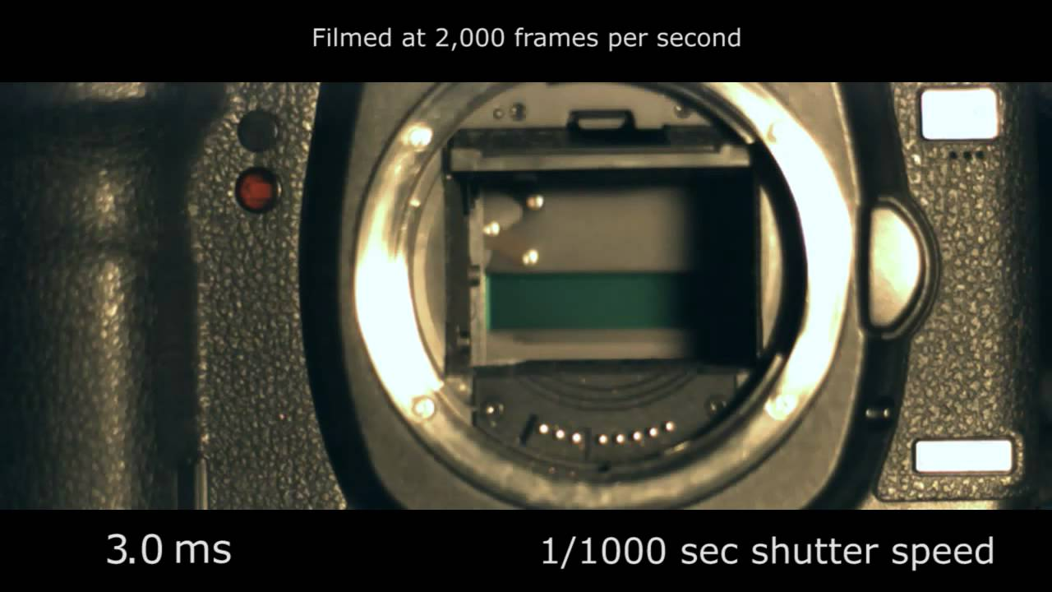
The Shutter
The shutter blocks all light from reaching the image sensor until you press the button. Then it quickly opens and closes, giving the image sensor a brief flash of light.

Slide 4
Shutter Speed
Shutter Speed is measured in second and looks like 1/500, 1/250, ½ or 1 as in one second etc.
It can range anywhere from 1/8000 to B for bulb
Bulb keeps the shutter open for as long as the shutter button is pressed down

Slide 5
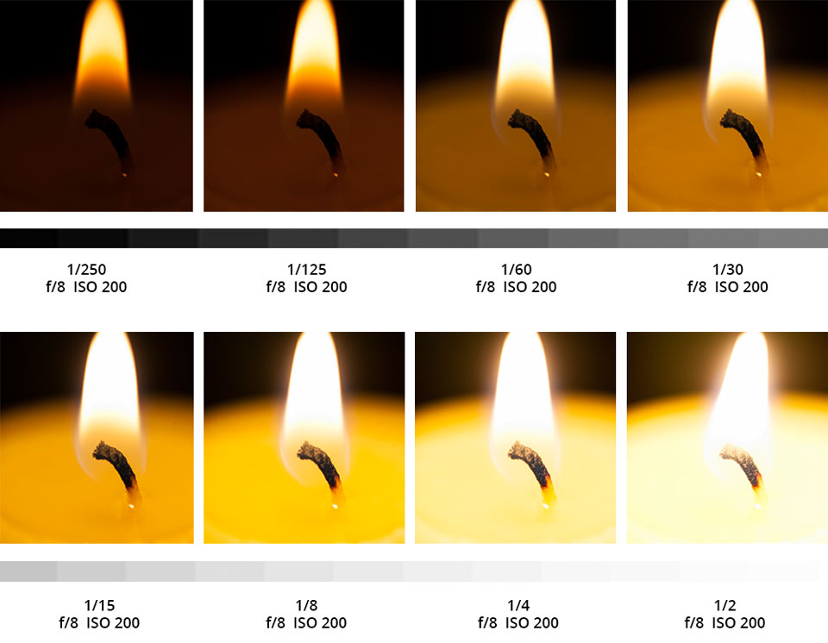
Shutter Speed
For pictures with the same aperture setting, if the shutter is open too long, the picture will be too bright, and if its not open long enough, the scene will be too dark. Therefore, you control the overall exposure (lightness and darkness) of the scene with both the aperture and shutter speed control.

Slide 6
What shutter speed to use
If you want to take a photograph of water frozen in action with every little bead in focus, then you would choose a fast shutter speed like 1/500 of a second.

Slide 7
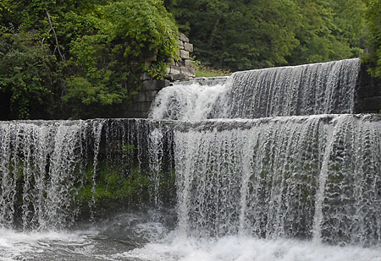
Fast Shutter speed 1/125

Slide 8
Blurred Movement
If you want to blur running water, then you would need to use a slower shutter speed like ¼ of a second
Often when you use a slow shutter speed, you will also need a tripod to help avoid camera shake

Slide 9
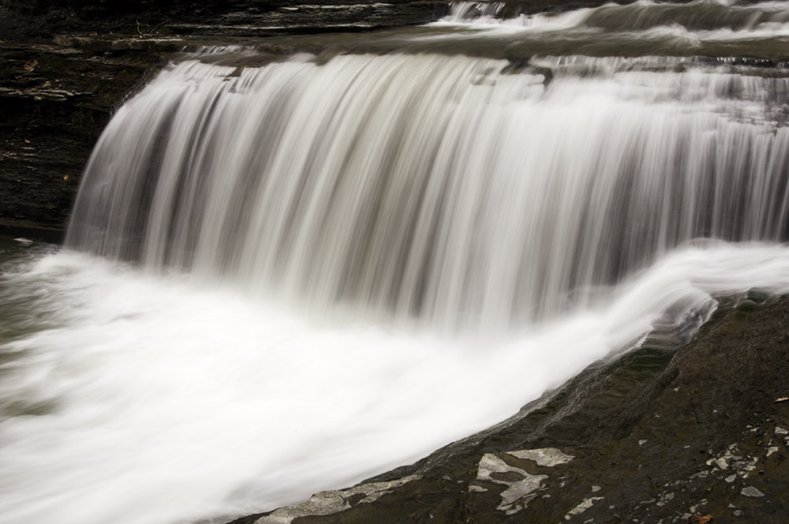
Slow Shutter speed-

Slide 10
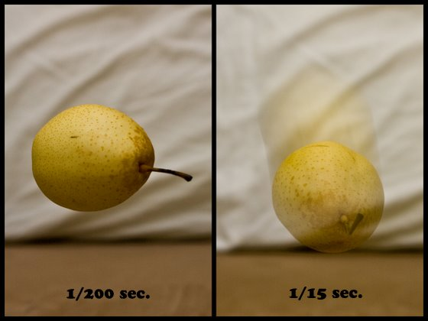
Shutter Speed
What you can do with shutter speed is freeze motion with a fast shutter speed or capture movement with a slow shutter speed.

Slide 11
Shutter Speed
Slow shutter speed, slows motion
Fast shutter speed, takes the image almost instantly as in frozen in time.
Use slow shutter speeds of at least 10 second or more for night shots of cities, buildings and streets, etc.
When using a slow shutter speed its also a good idea to use a tripod and remote shutter release to avoid camera shake

Slide 12
Assignment:
We are now using MANUAL settings on the camera. Everytime you pick up the camera to shoot you think about:
Aperture
Shutter Speed
White Balace
To start off figuring out how to adjust and play with all of your settings at the same time, our first shutter speed assignment will be fairly simple:
-3 slow SP, 3 fast SP studio pictures

Slide 13
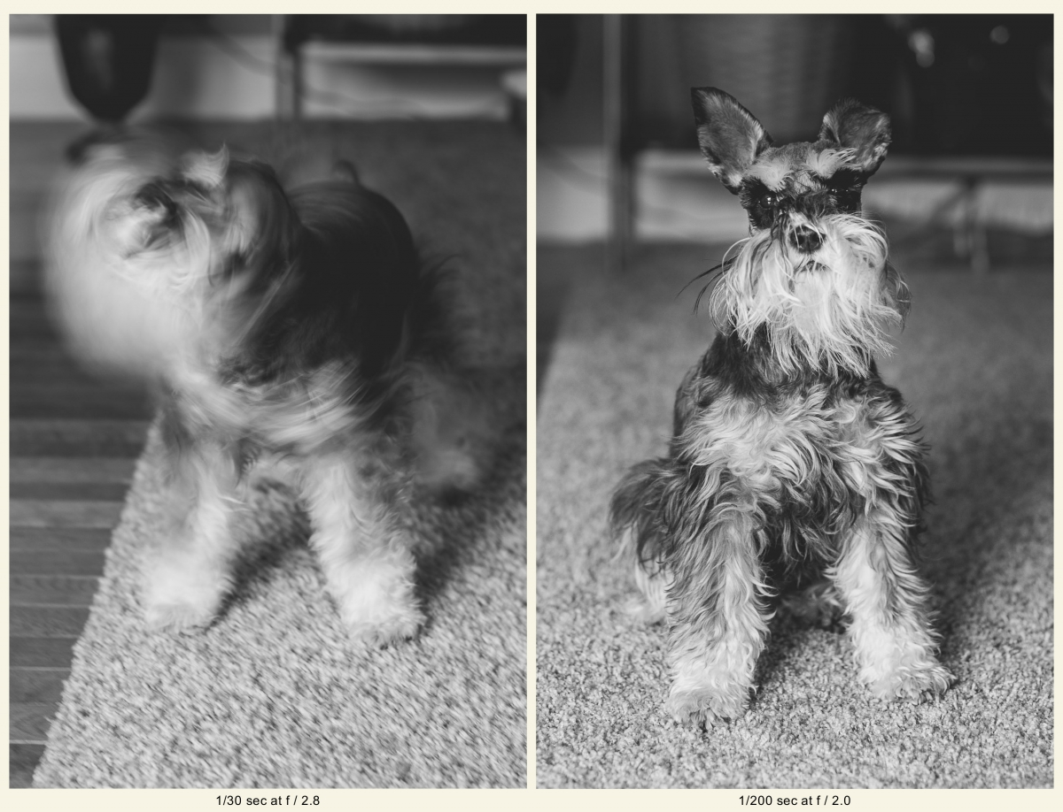
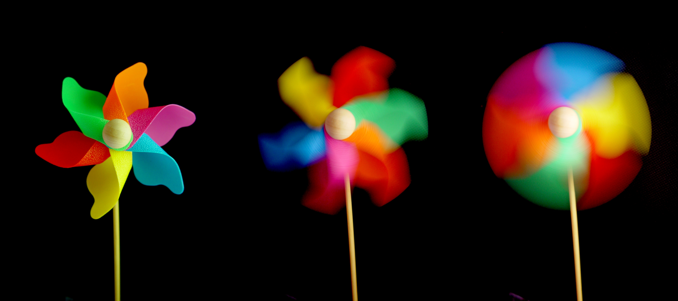
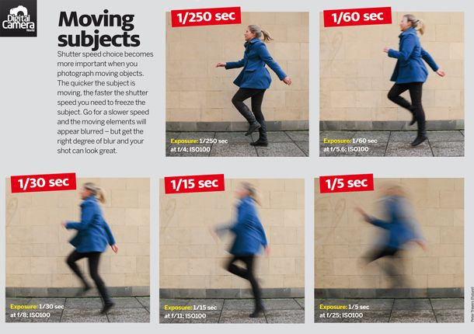

Slide 14
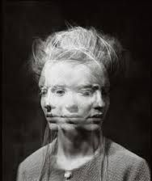
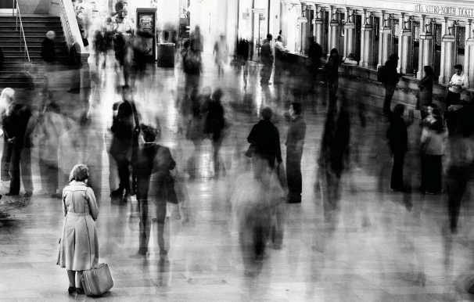
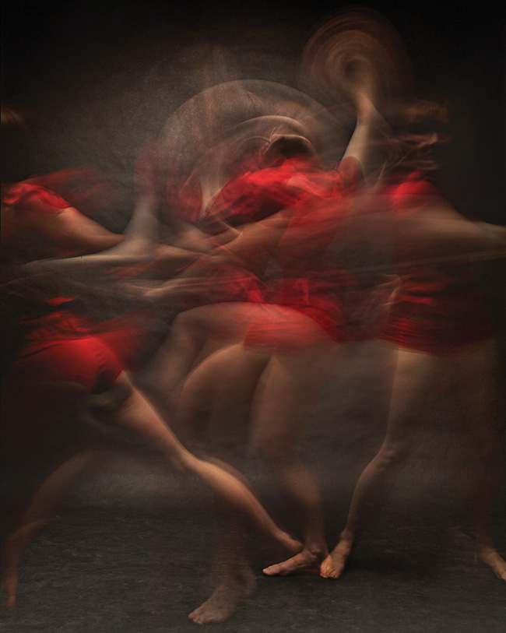
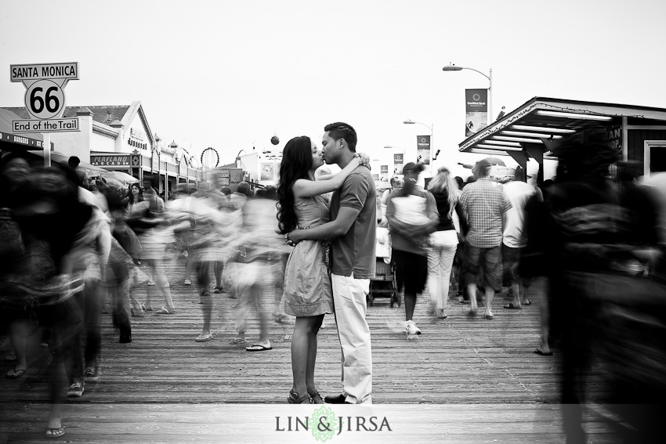
Halloween
3 ghost

Slide 15
How to work manually
Fast Shutter Speed = Less Light (compensate –F number)
Slow Shutter Speed = More Light (Compensate + F number

Slide 16
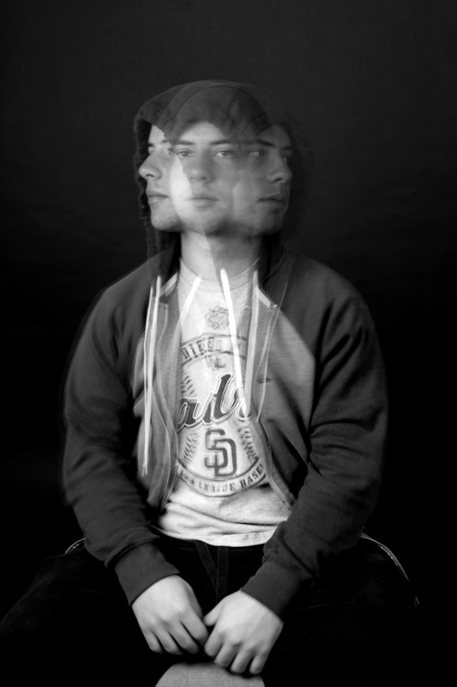

Slide 17
